Slide 1

Elo World Team: Jon, Ben, Eleanora & Shrawantee

Slide 2
Elo Merchant Category Recommendation
Elo, one of the largest payment brands in Brazil, has built partnerships with merchants in order to offer promotions or discounts to cardholders.
For these promotions to work for either the consumer or the merchant, Elo has built machine learning models to understand the most important aspects and preferences in their customers’ lifecycle, from food to shopping.
But so far none of them is specifically tailored for an individual or profile.
We attempt to develop algorithms to identify and serve the most relevant opportunities to individuals, by uncovering signal in customer loyalty.

Slide 3
What are we predicting?
A loyalty score (target) for each customer (card_id) represented in test.csv and sample_submission.csv.
Number of Variables = 147
Few variable names and description
List of anonymized variables

Slide 4
Flow of the presentation
Description of the data: Tableau
Pipelining the data (Python)
Principle Component Analysis (Python)
Algorithms (Python)
Multivariate Linear Regression
Lasso
Random Forest
Neural Network
LGBM (Light Gradient Boosting Machine)
Logistic Regression
Conclusions

Slide 5
Descriptive Statistics : Tableau

Slide 6
Pipelining

Slide 7

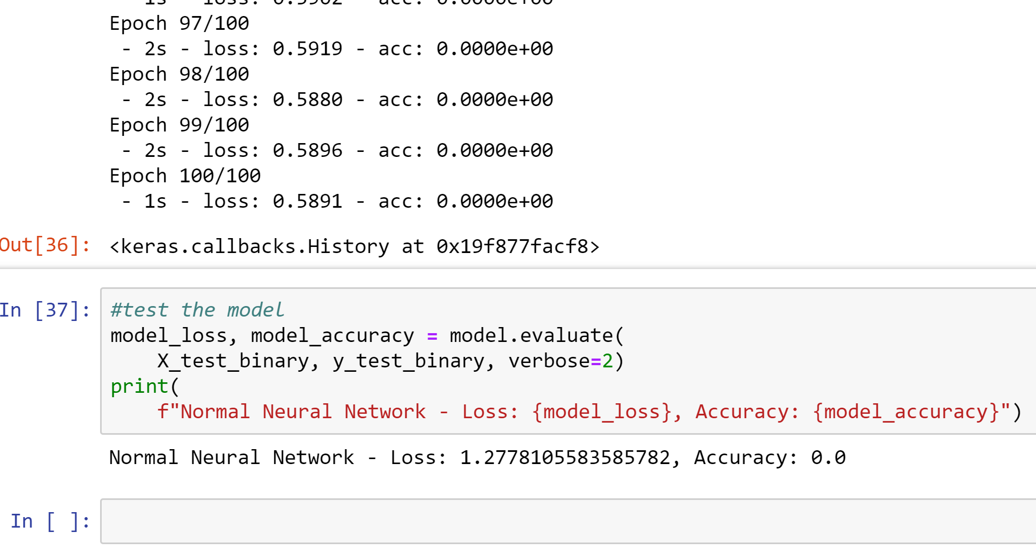
Neural Network
Encountered many issues with data as it was, so we needed to narrow down the important columns
Binned target results based on “Loyal” and “Disloyal” scores
Scaled data to range between 1 and 0
Did a principal component analysis to determine most variance in the data and to make network easier to run, picked 50 columns that accounted for 95% of variance.
Ran Neural Network, achieved a accuracy of 0.
Conclusion:
This is a complex dataset that may require multiple kinds of models working in synchrony to make accurate predictions.

Slide 8
Multivariate Linear Regression

Slide 9
Lasso

Slide 10
Random Forest

Slide 11
LGBM (Light Gradient Boosting Machine)

Slide 12
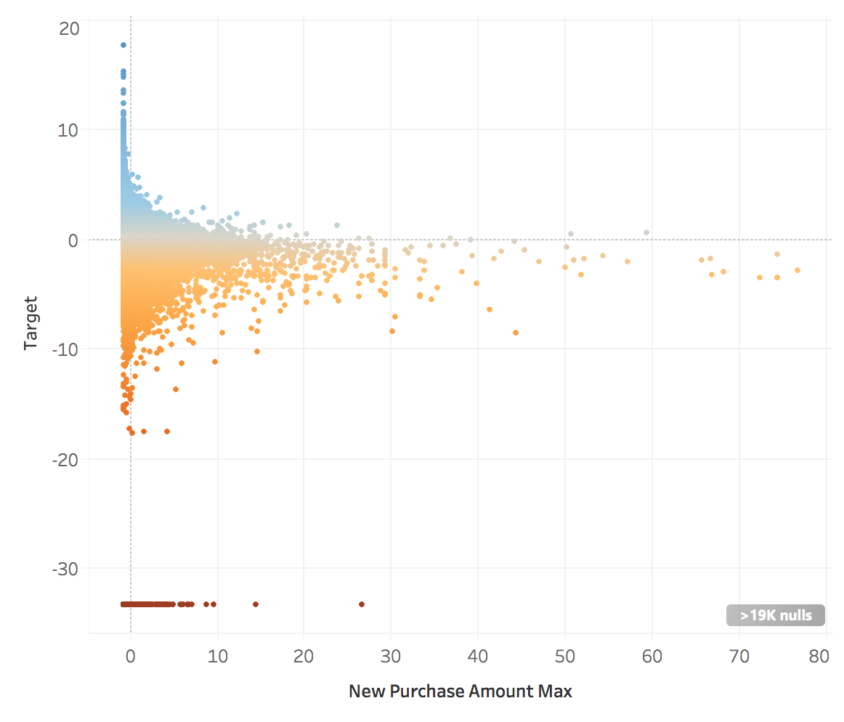
Logistic Regression

Slide 13
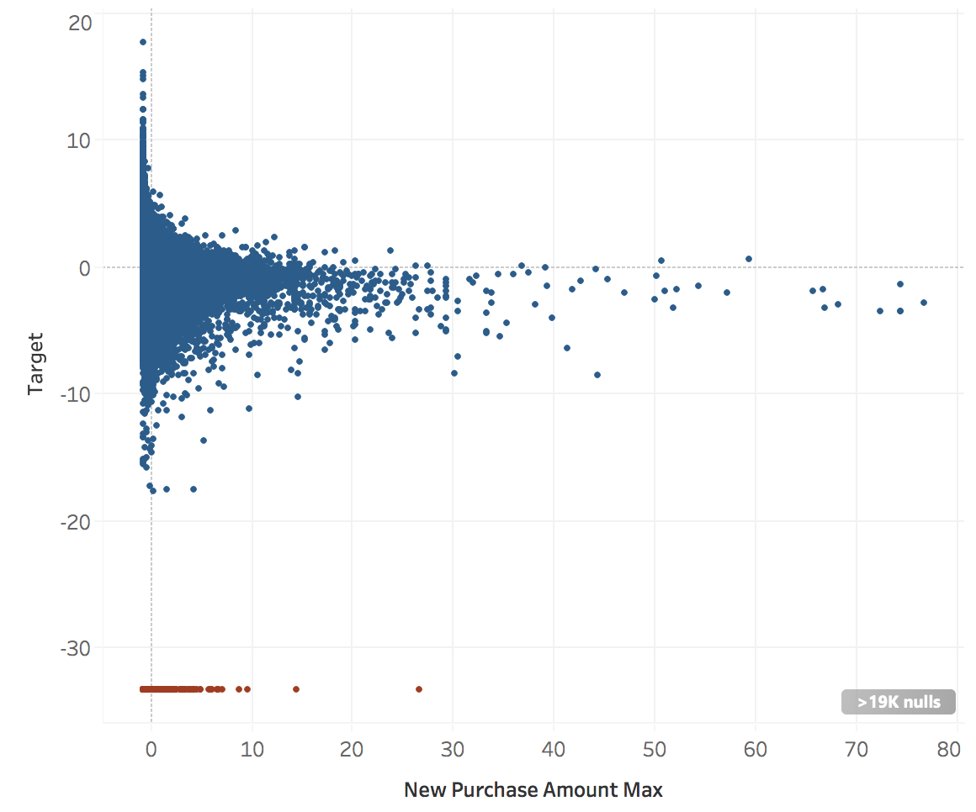
Logistic Regression
Loyal
Disloyal

Slide 14
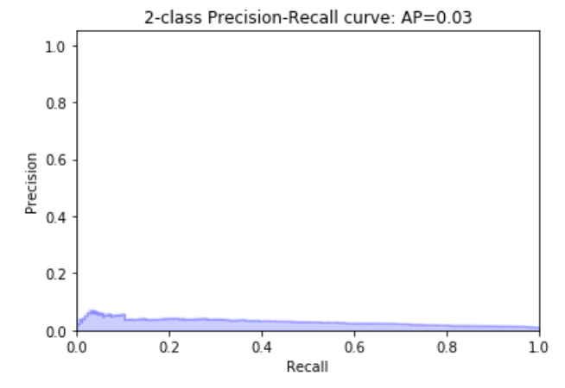
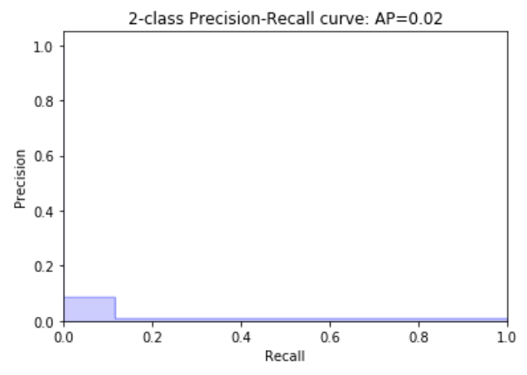
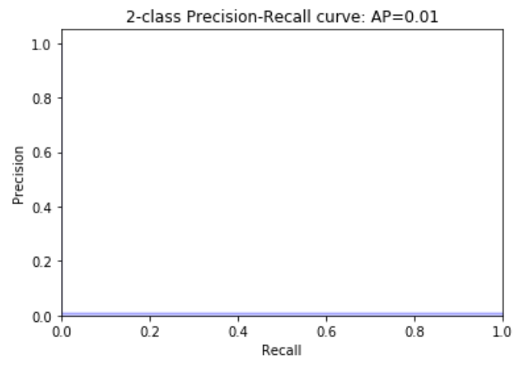
Logistic Regression
Decision Tree
Random Forest

Slide 15
Conclusion

Slide 16


